Slide 1
Synthetic Fraud Detection Using Generative Modeling and Anomaly Detection
Report by Megha Agarwal
Notes:
Objetivo del proyecto
En este proyecto, elegirás un escenario, recopilarás datos de referencia para él y usarás Microsoft Copilot para complementar o ampliar tus datos. Después, aplicarás tus datos a una tarea de análisis de datos. Finalmente, elaborarás un informe técnico que evaluará las soluciones de IA Generativa (GenAI) para tareas específicas de ciencia de datos, abordando las cuestiones de seguridad y privacidad de los datos.
Escenario del proyecto
Comencemos con el contexto. Imagina que eres un prometedor científico de datos. Basándote en un escenario elegido, recopilarás tus datos de referencia e integrarás IA generativa de vanguardia en tu flujo de trabajo. Microsoft Copilot, un potente asistente de IA, es la herramienta que utilizarás para optimizar procesos, complementar tus datos y descubrir nuevos conocimientos. Sin embargo, los riesgos potenciales de la IA en la ciencia de datos, como el sesgo, la desinformación y las violaciones de la privacidad de los datos, deben considerarse cuidadosamente y mitigarse. Tu reto es demostrar los beneficios de Copilot y, al mismo tiempo, garantizar un uso ético y responsable de la IA.
Objetivo
Este proyecto tiene como objetivo crear un portafolio completo que demuestre su dominio de Microsoft Copilot en ciencia de datos. Su portafolio debe demostrar su capacidad para:
Utilice Copilot en distintas etapas del proceso de ciencia de datos.
Aplicar modelos de IA generativos (GAN, VAE o Transformers) para resolver problemas de ciencia de datos del mundo real.
Identificar y mitigar los posibles riesgos de seguridad y privacidad de los datos asociados con la IA generativa.
Comunique sus hallazgos, metodología y consideraciones éticas de manera eficaz.

Slide 2
Problem Statement: What factors impact weather a mother will be able to deliver child through natural birth. Due to the sensitivity of this data; copilot can help generate synthetic data, enabling analysis and model creation.

Slide 3
1 a) Generate Synthetic data using Co-pilot to build the model
Starting prompt
can you create a synthetic data set with 1000 rows for me which contains this information full name of mother, age of mother, gender of child, ethnicity of mother, procedure weather natural birth or cesarean.

Slide 4
1 b) Results in Excel after running the python script : Top Ten for reference)
Full Name of Mother Age of Mother Gender of Child Ethnicity of Mother Procedure
Sophia Williams 40 Male Middle Eastern Natural Birth
Charlotte Johnson 43 Male Pacific Islander Natural Birth
Ava Hernandez 43 Male Other Natural Birth
Charlotte Johnson 28 Female Native American Natural Birth
Emily Johnson 32 Female Pacific Islander Natural Birth
Evelyn Smith 44 Female Pacific Islander Natural Birth
Emily Hernandez 29 Male Middle Eastern Cesarean
Ava Jones 39 Female White Cesarean
Emily Smith 28 Male Black Natural Birth
Isabella Johnson 24 Male Other Natural Birth

Slide 5
2 b) Data analysis using Co-Pilot Web and in Excel
I then used Co-pilot Gen AI Web version to find outliers by variables such as Team
An example prompt was : “please evaluate this data and find anyone who is more than two standard deviations above or below the Hours studied 2024 based on their team”
As example output is provided below:
🧠 Outliers by Team
Sales
Above Average:
Jennifer Smith – 173 hours
Elizabeth Wilson – 170 hours
Elizabeth Miller – 168 hours
Below Average:
Robert Davis – 126 hours

Slide 6
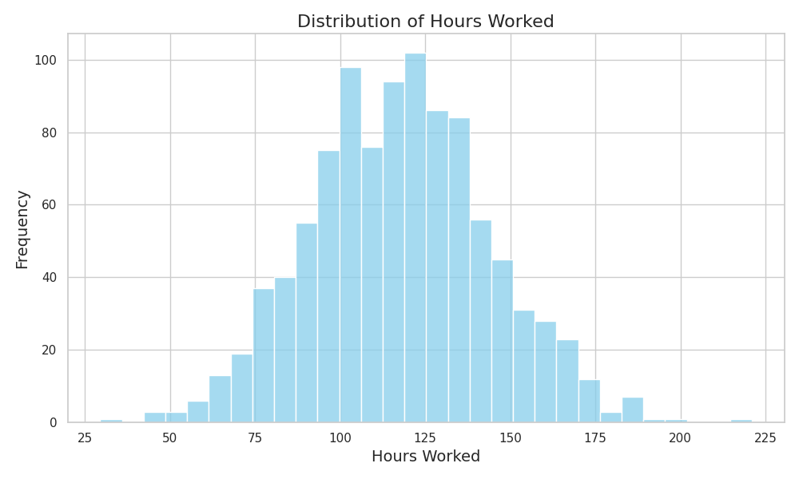
2 a) Data analysis using Co-Pilot Web and in Excel
As an initial analysis I used Copilot in Python to plot the average hours in a barchart (below), nothing that the results follow a normal distribution. With the average of 117 hours and a standard deviation of 27

Slide 7
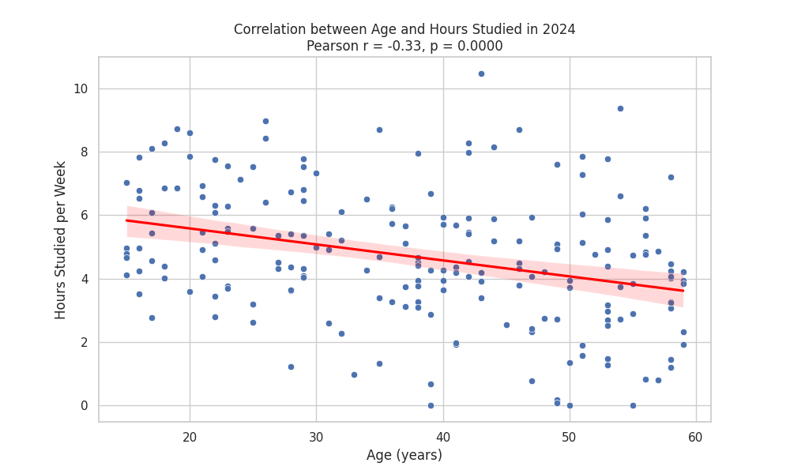
2 c) Data analysis using Co-Pilot Web and in Excel
I then also used Co-pilot Gen AI to find visualise some of the findings such as age vs hour. This should a slight negative correlation between age and hours (-0,33)

Slide 8
3 a) Implementing a random forest model
After analysing these findings I thought it would be helpful for the project to look at the variables in combination rather than in isolation by employing a random forest model.
I used this prompt to create a Random Forest Model in python.
Please help me create a random forest model using my employee data file which would provide insights that management could leverage to understand current habits and make suggestions on improvements

Slide 9
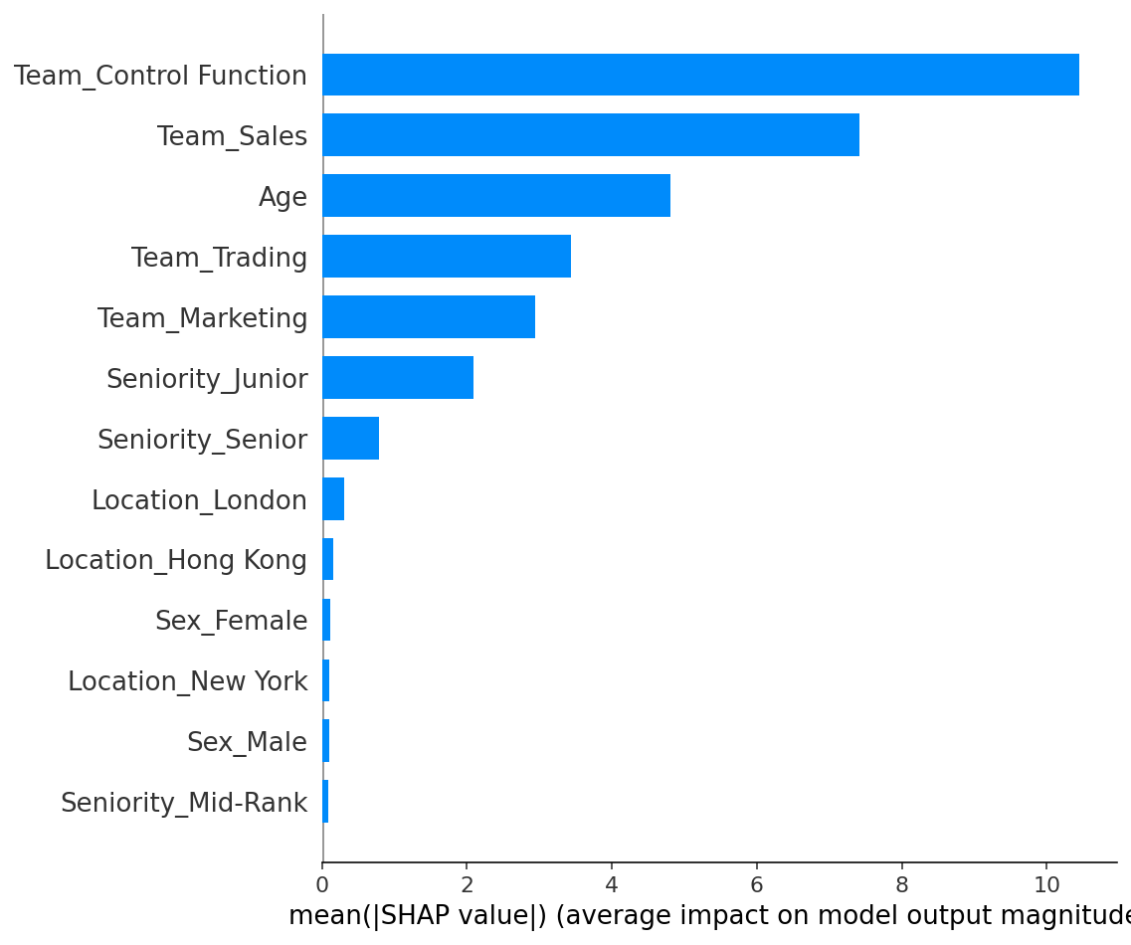
3 b) Implementing a random forest model
This took some iterations to get the code I needed but after some changes the model showed me this high level result. The chart shows that variables such as Team, Age and Seniority had some impact on the model but Gender or Location had negligible influence

Slide 10
3 c) Implementing a random forest model
Finally I asked Co-pilot to enhance the Python code to show outlers in the model. This returned the following results
=== Top 5 Over-Achievers ===
Patricia Jones: studied 135.0h vs. 116.2h predicted (+18.8h)
James Rodriguez: studied 125.0h vs. 108.9h predicted (+16.1h)
Elizabeth Wilson: studied 132.0h vs. 116.1h predicted (+15.9h)
Jennifer Jones: studied 91.0h vs. 75.3h predicted (+15.7h)
Robert Garcia: studied 172.0h vs. 156.7h predicted (+15.3h)
=== Top 5 Under-Achievers ===
Linda Rodriguez: studied 95.0h vs. 114.0h predicted (-19.0h)
Jennifer Garcia: studied 78.0h vs. 92.0h predicted (-14.0h)
Mary Garcia: studied 77.0h vs. 90.8h predicted (-13.8h)
John Johnson: studied 127.0h vs. 140.7h predicted (-13.7h)
John Smith: studied 139.0h vs. 152.6h predicted (-13.6h)

Slide 11
4. Considerations for implementing the model with real-life data
Before implementing a model in a company the following must be considered
Internal Company Policy : most large corporations will likely have policy which informs decisions on using AI/data in the workplace. This would typically be guided by regulations and include factors such as “needs to know”, fairness and transparency, cyber risk model governance, third party governance (if model or data is externally owned), bias and the risk of hallucinations
Regulatory considerations : In particular model owners may consider implications from regulators such as the EU AI Act, GDPR, ISO 42001 and the Hong Kong SFC Circular on Generative AI. In particular model owners may consider if the use-case places them in the scope of high risk or even unacceptable risk by these definitions. For instance, this particular model is unlikely to reach the level of high risk based on the SFC circular which defines this as “investment recommendations, investment advice or investment research to investors or clients” but may come in scope of high risk under the EU AI Act, “AI applications used in critical infrastructures, education, employment, law enforcement, migration, and judiciary
When implementing the model such guidance should be considered and risk mitigated. For instance, data attributes such as Age and Gender are likely to be more sensitive than team membership.Model owners should consider removing such attributes unless they serve a particular business need e.g. a Diversity and Inclusion initiative is looking to see if gender plays a part in participation with an aim to improve opportunities for those wanting to study more. This should nevertheless be carefully considered against internal guidelines and external regulations.
Finally when real-life data is used further cleansing and checks (perhaps with qualitative feedback from colleagues) should be performed. For instance, no consideration in the model has taken place to determine if employee had worked a full year and hence were likely to have less hours studied. For this case, considering teh hire date to either remove people or to enhance the model output should be considered.

Slide 12
5. Findings
Any implementation of such a project would first need however careful consideration against the guidance highlighted in section 2
Providing criteria 1 is met, findings such as those outlined in section 1b could then be used to improve overall participation. For instance “over-achiever” interviews could be conducted to understand qualitatively what has led them to score so highly e.g. supportive management, personal motivation or each of access. Similarly handled sensitively “under achievers” could also be interviewed to determine what could help them to study more e.g. their team work hours are longer than other departments and could be more balanced etc.
Such findings could then for instance be used to start an internal marketing campaign to guide others to increase their participation and overcome barriers..

Slide 13
Project ends here
The rest of the slides were provided in the original analysis provided in the course

Slide 14
Conclusion and Recommendations
Summary
Microsoft Copilot significantly improved productivity and model performance in fraud detection.
Generative AI models effectively supplemented scarce data sources.
Recommendations
Integrate Copilot and generative AI into fraud detection workflows.
Regularly review ethical practices and privacy measures.
Explore additional AI models for improved synthetic data so that there is not more difference between synthetic and Reference data .

Slide 15
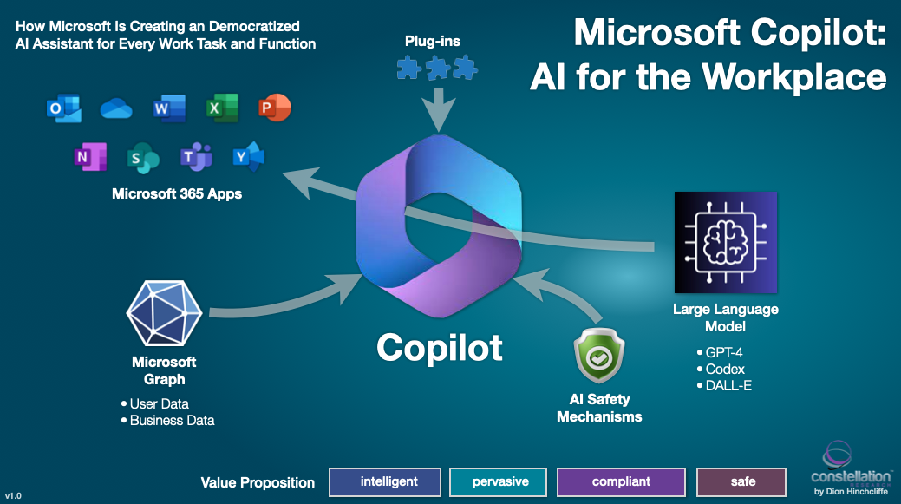
Grading Criteria
Copilot proficiency: How effectively did you use Copilot throughout the project?
Technical knowledge: Do you strongly understand generative AI and data science?
Problem-solving skills: Did you effectively identify challenges and apply AI solutions with Copilot's help?
Ethical awareness: Did you consider and address the potential ethical implications of generative AI? What steps did you take to anonymize data or avoid using sensitive data?
Communication skills: Are your project objectives, methodology, results, and implications communicated in both written and (optional) oral formats?

Slide 16
Using Copilot Across the Data Science Workflow
Data Cleaning: Imputation, outlier removal
Exploration: Summary statistics, visualizations
Feature Engineering: Patterns by time/location
Model Training: Classification and tuning
Interpretation: Feature importance insights

Slide 17
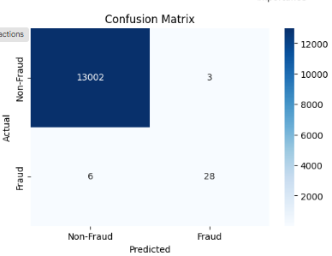
Model Development Workflow
Train baseline Random Forest on real data( baseline model confusion matrix in Figure )
Use GANs to generate synthetic fraud data
Merge synthetic and real data
Train multiple models with GridSearchCV

Slide 18
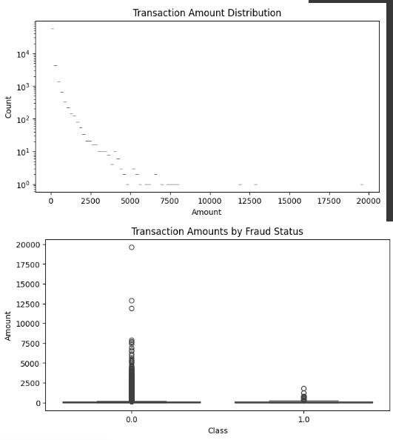
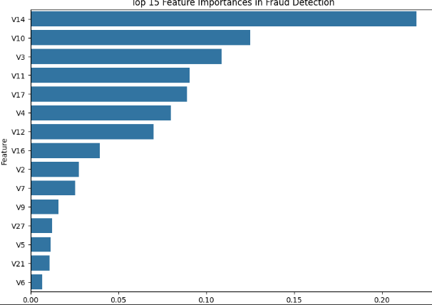
Visualization
Top Plot (Transaction Amount Distribution):
The majority of transactions involve small amounts, as indicated by the high count on the left side of the plot.
There are very few high-value transactions, resulting in a long-tailed, right-skewed distribution.
Bottom Plot (Transaction Amounts by Fraud Status):
Both fraudulent and non-fraudulent transactions are mostly for low amounts, but there are some large outliers in both classes.
High-value transactions are rare and occur in both fraud and non-fraud cases, suggesting amount alone is not a clear fraud indicator.
This horizontal bar chart shows that feature V14 is by far the most important variable in detecting fraud, followed by V10 and V3. The remaining features contribute less, with a sharp drop in importance after the top few features.

Slide 19

Project Objective and Scope
Showcase Microsoft Copilot in a real data science workflow
Use GANs to improve fraud detection with imbalanced data
Address security, privacy, and ethical considerations
Deliver a complete project portfolio

Slide 20
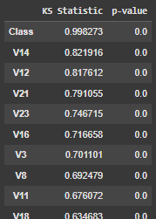
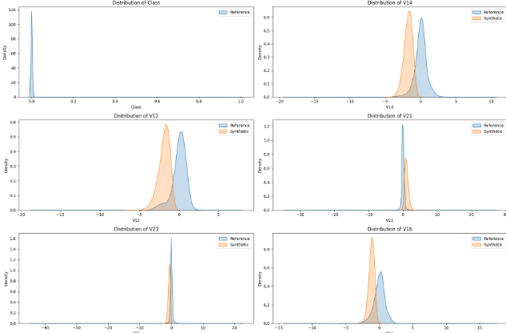
Synthetic Data Validation
Used KS-test to validate distribution match
Preserved key fraud indicators
High KS Statistic values (close to 1), especially for "Class" and V14/V12, indicate significant distribution differences between your real and synthetic data for these features.
Very low p-values (0.0) confirm these differences are statistically significant.
For all features shown, the synthetic data distributions (orange) are similar in shape to the real/reference data (blue), but generally shifted—there are visible differences in means and some spread.
The synthetic data is broadly realistic, but not identical to the real data, especially for the shown features

Slide 21
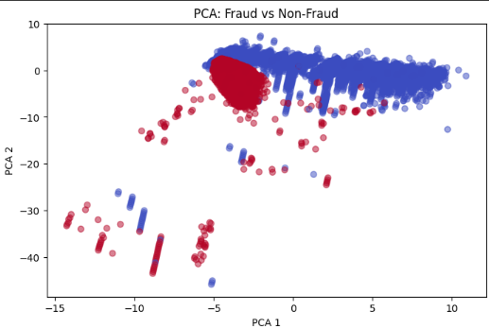
Visualized with PCA: after validation and combined real and synthetic data
The PCA plot shows that fraud (red) and non-fraud (blue) transactions form distinct clusters, with some overlap. This suggests that the main principal components capture meaningful differences between fraudulent and non-fraudulent behavior.

Slide 22
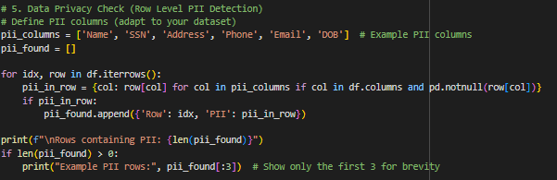
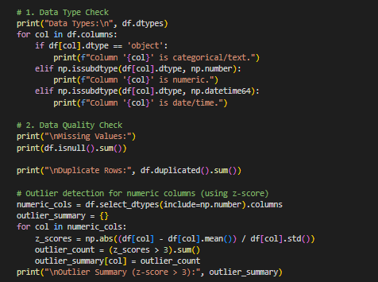
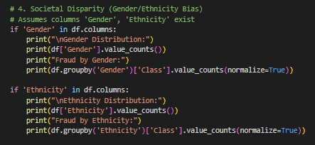
Data Security and Privacy(some copilot generated code in here )
Data Privacy
Anonymized Features: Original dataset uses anonymized variables (V1–V28), reducing PII exposure.
PII Handling: Real-world data must be checked and sanitized for personally identifiable information.
Synthetic ≠ Safe by Default: Poorly generated synthetic data may still leak real patterns — did rigorous validation (e.g., KS test, distributions)
🔒 Data Security( implemented in Full security model )
Secure Storage: Encrypt data, models, and outputs; enforce access control.
Encrypted Model Saving: Notebook uses encrypted model storage via joblib + cryptography.
Audit Logging: Track model access and updates to ensure traceability.
Prevent Data Leakage: Preprocessing done post-split to avoid leakage; improves robustness and privacy.
⚖️ Bias Mitigation
Bias Monitoring: Evaluate model fairness across groups .
Synthetic Bias Risk: GANs trained on biased data may reinforce those biases — inspect and validate outputs.

Slide 23
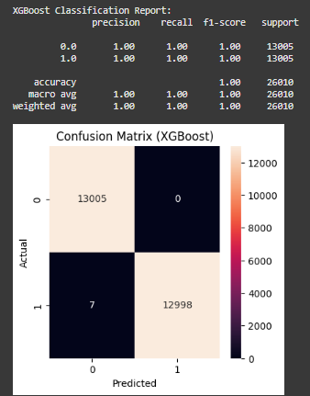
Results and Key Insights
Synthetic data boosted rare fraud detection
Copilot accelerated development
Ethical and privacy risks were managed
The XGBoost model achieved perfect precision, recall, and F1-score for both classes, with only 7 misclassified fraud cases out of 26,010 transactions. The confusion matrix shows almost perfect separation between fraud and non-fraud, indicating outstanding fraud detection performance.

